Slide 1
The American Automobile “A Brief History” Part 3 The Interstate System Tail Fins and Compacts Muscle Car Era 1970 Oil Embargo
Kenton Colvin
OLLI – Fall Term 2019

Slide 2
Course Outline
October 8 – Introduction, invention, mass production, WW I, Depression (1890’s to 1920’s)
October 15 – Roaring 20’s part 2, New Deal, pre and post WW II, Labor Unions (1920’s to 1940’s)
October 22 – Interstates, Korean War, Tail Fins, Muscle Cars, Oil Embargo (1950’s to 1970’s)
October 29 – Japanese Automobiles, Quality, Major Improvements.(1980’s to Present)

Slide 3
Post War Labor Relations
GM – UAW agreement was a 2 year contract of historic importance.
Established a pattern widely followed in the next decade.
Main feature: provision to adjust wage rates based on the cost-of-living index, computed by the U.S. Department of Labor.
Second feature: An annual ‘improvement factor” calculated to allow for increased productivity of the worker from advances in manufacturing techniques.
When this agreement expired in 1950 it was renewed with some modification for another 5 years.
UAW negotiated a contract with Ford in 1949: All of Ford employees who served 30 years were guaranteed a retirement income of $100 a month, where the company made up the difference between that figure and the employee’s Social Security Benefits.
These contracts were adopted by many other industries. Contracts were good for all, however, also gave room for future automation.

Slide 4
Peace Has its Problems
The major question marks in the management of the auto industry were personified by two Henrys – Henry Ford II and Henry J. Kaiser.
Henry Ford II: could he rehabilitate the Ford Motor Company.
May 26, 1943 President of the company - Edsel Ford died.
Victim of fathers prejudices.
Stomach ulcers from frustration and persecution from elder Ford and Harry Bennett turned to cancer.
Aggravated by undulant fever brought on by drinking unpasteurized milk from the family farm.
Vacant presidency was taken by 80 year old Henry already the victim of 2 strokes. Only person who liked the arrangement was Bennett.

Slide 5
Peace Has its Problems
Government concerned about Henry, they left Henry Ford II (oldest of Edsel’s sons) out of the service in the Navy to assist in the management of the company.
Late 1943 he was made VP. Allies in the Ford women. September 21, 1945 Henry finally relinquished the control of the company to Henry Ford II. Tragic end.
Ford was losing money at $9 million each month. Henry’s help:
Hired Ernest Breech (GM) who held many offices – mainly financial who became executive VP and later moved up to president.
Ten air force officers ranging in age from 26-34 who had been concerned with logistics and especially with financial and statistical controls applied and were hired. Dubbed “Whiz Kids”.
Ford became profitable again. In 1950, Ford recovered second place in sales from Chrysler.

Slide 6
1940’s Highlights
1945: Clayton Moore who portrays the Lone Ranger on radio buys the first 1946 Pontiac.
1946: January steel strike closes assembly lines. In addition, the industry faces critical shortages of copper, brass, lead.
1946: November auto price and wage controls are lifted.
1947: Inflation is a serious problem throughout the entire economy. Most makes differ little from 1946.
1947: Packard offers hydraulic power seats and window in some topline models.
1947: Lincoln marks is 25th Anniversary.

Slide 7
1940’s Highlights
1947: Studebaker has already introduced all-new postwar design with a similar front and rear shape – jokes about the Champion and Commander looks same coming or going.
1947: Chrysler and GM sign new union contracts.
1947: Manufacturers approve an SAE standardize bumper heights.
1947: Chrysler ride Goodyear low-pressure “Super Cushion” tires.
1948: Critical material shortages and labor strife continue all year.
1948: Wage disputes close many auto plants in the spring.
1948: Independents earn 22% market share versus 9.3% in 1941.

Slide 8
1945 Studebaker

Slide 9
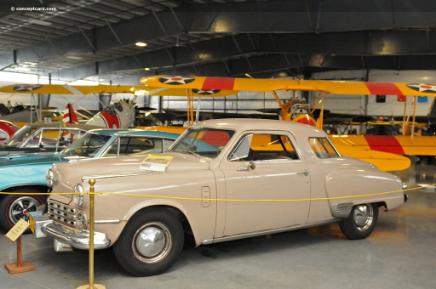
1947 Studebaker Commander

Slide 10
1940’s Highlights
1948: Buick introduces its Dynaflow torque-converter automatic transmission, available on Roadmasters.
1948: Pontiac offers Hydra-matic – automatic transmission.
1948: 100 millionth vehicle is produced.
1948: Studebaker begins production at its new Hamilton, Ontario plant.
1948: The Playboy convertible is ready for pilot production in April and announced production to start a 3 per day.
1949: Never had American automobiles changed more in a single year.
1949: January Chevrolet is first automaker to advertise on TV, others would soon follow.

Slide 11
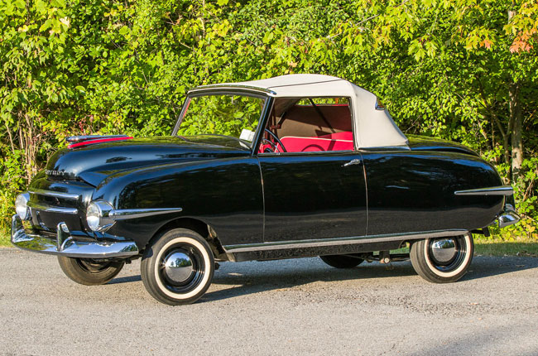
1947-49 Playboy Convertible

Slide 12
Henry J. Kaiser
Colorful figure from California who Rose to national prominence during WWII by impressive production performances, especially in shipbuilding.
Instrumental in starting steel manufacturing on the Pacific Coast. During the war Kaiser joined forces with Joseph W. Frazer, president of the Graham-Paige Motor Company, to undertake the large-scale manufacture of automobiles when peace came.
1945: Formed the Kaiser-Frazer Corporation:
Manufacturing facilities were acquired at bargain prices by purchase or lease of government owned plants built for the war effort.
Credit: available from government sources, notably Reconstruction Finance Corporation which loaned him $44 million in 1949.
1948 automobile line up: Kaiser, Frazer, Henry J. - held 5% of the market. Within 5 years all three models disappeared.

Slide 13
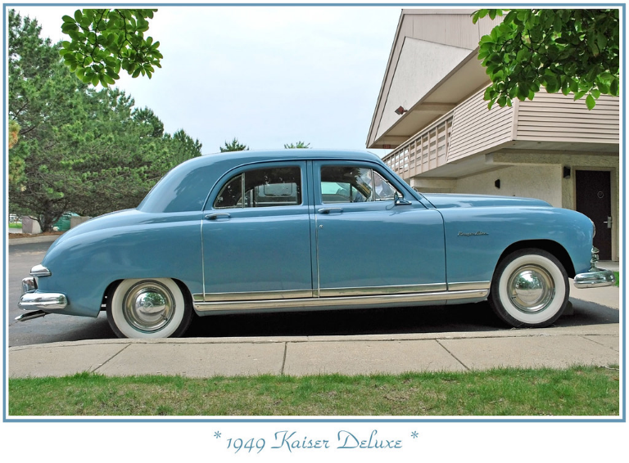
1949 Kaiser Deluxe

Slide 14
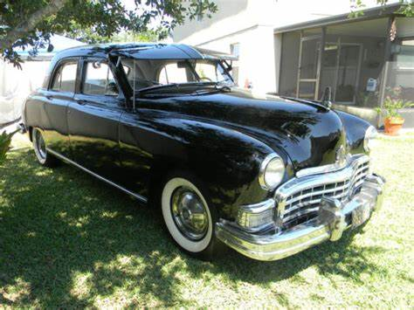
Frazer 1949

Slide 15
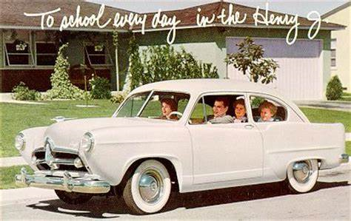
1949 Henry J 1951

Slide 16
Preston Tucker
Flamboyant Chicago businessman.
Proposed to build a rear-engine auto with sports car lines, tentatively called the Torpedo.
Tucker Corporation leased a government built factory where Dodge made B-29 bombers.
Ran into financial problems and went out of business in 1949.
Many believe that the Tucker car was ahead of its time and the Big Three wanted him to fail.

Slide 17
Tucker Torpedo 1948

Slide 18
Tucker Torpedo 1948

Slide 19
Tucker Torpedo 1948

Slide 20
Tucker Torpedo 1948

Slide 21
Crosley Corporation
Attempted to make a smaller car that would later be termed a “Compact Car”. A lightweight car with a 4-cylinder engine.
First appeared in 1939 but since it scarcely had time to go into production prior to the War, it is considered a postwar car.
Had proper finances by being supported by the manufacturers of Crosley radio and television equipment.
Survived until 1952 when the company was purchased by General Tire and Rubber Company and production of the car ceased.
Had the Crosley still been in the market 5 years later, it could have conceivably been a huge success.

Slide 22
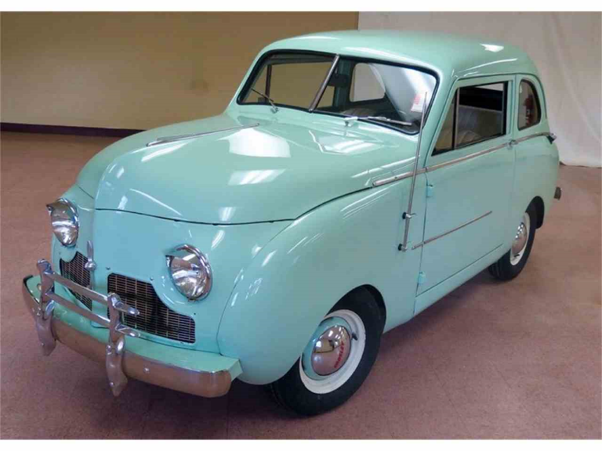
Crosley Car 1947

Slide 23
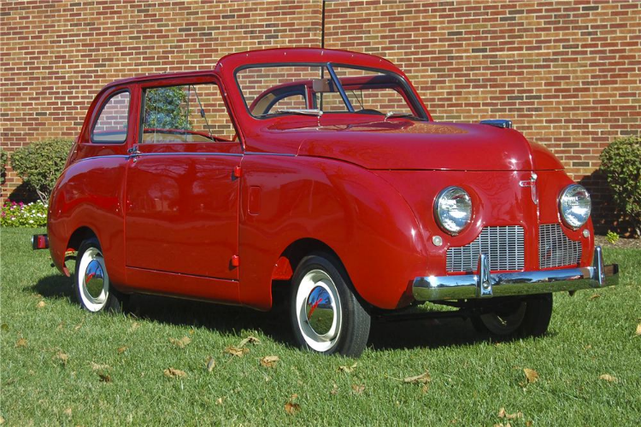
Crosley Car 1948

Slide 24
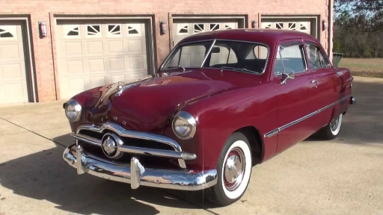
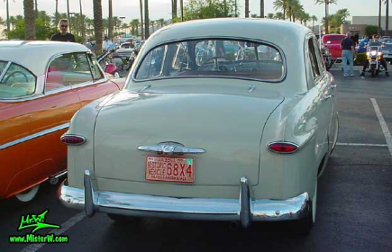
1949 Ford Coupe and Sedan

Slide 25
1940 Mercury Eight (1st Gen 39-40)

Slide 26
1948 Mercury Eight (2nd Gen 41-48)

Slide 27
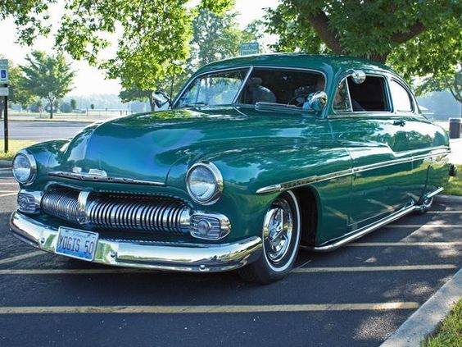
1949 Mercury Eight (3rd Gen 49-51)

Slide 28
1940 Lincoln El Series

Slide 29
1949 Lincoln Eight Sport Coupe

Slide 30
1949 Chrysler Windser

Slide 31
1940 Desoto

Slide 32
1949 Desoto S-13 Custom

Slide 33
1949 Dodge Wayfarer Coupe

Slide 34
1949 Dodge Coronet (D30)

Slide 35
1949 Plymouth Special Deluxe

Slide 36
The Broad Highway
In 20 years following WW II the outstanding feature of the American automotive was the great advancement in highway design and construction rather in the evolution of the vehicle itself.
Normal sources for highway funds: Interstate and Defense Highway Act of 1944. Covered federal spending on highways "after the war", which (after WW II ended August 1945) meant spending in fiscal 1946, 1947, and 1948. Among the act's provisions were:
Creation of a 40,000-mile National System of Interstate Highways to connect major cities and industrial areas.
Creation of a system of secondary roads designed to bring traffic to the interstate highways.
Yearly expenditure = $225 million general federal highway; $125 million interstate highway system; and $150 million secondary/feeder roads.
Even with new roads there was a tendency to emphasize economy rather than expediting of traffic, so that curves were sharp and grades were steep.

Slide 37
The Toll Roads
As the highway authorities and engineers agreed what was needed was a network of trunk roads constructed as multi-lane limited-access expressways.
Difficulty in that they were expensive to build. Costs persistently outran revenues.
Consequently state after state turned to the example offered by the Pennsylvania Turnpike.
PA Turnpike Funding for initial 160 mile section:
$29.2 million (40%) from Public Works Administration
$40.8 million came as a loan form the Reconstruction Finance Corporation

Slide 38
The Toll Roads
At the end of the war it was evident that motorists were willing to pay tolls for the privilege of traveling on toll roads.
Toll roads have common characteristics:
Limited access
Separate roadways for traffic in opposite directions
Designed for high speeds
Interchanges generally follow the cloverleaf pattern or similar design
Service areas or rest stops are offered
When PA Turnpike reached its 20th anniversary in 1960, it was handling an average of 60,000 vehicles per day and on holidays there were tie ups as there were 2 lanes in some tunnels, etc.
Toll roads fulfilled effectively the purpose they were intended: to provide up-to-date express highways that would pay their own way.

Slide 39
Interstate Highway Act of 1956
Federal-Aid Highway Act of 1956, popularly known as the National Interstate and Defense Highways Act, June 29, 1956.
Authorization: $25 billion for construction of 41,000 miles supposedly over 10-years. Largest public works project.
Addition of "defense" in the act's title was for two reasons:
Some original cost was diverted from defense funds.
Most U.S. Air Force bases have a direct link to the system.
Cost of construction approximately $114 billion ($900 billion today). Construction proclaimed complete in 1992, though some planned routes were canceled and several routes had stretches that did not fully conform with federal standards.

Slide 40
Interstate Highway Act of 1956
Though much of their construction was funded by federal government, the highways are owned by the state.
Federal standards: Have controlled access, minimal traffic lights, and comply with federal traffic sign specifications.
Numbering scheme: Primary interstates are assigned one- or two-digit numbers and shorter routes are assigned three-digit numbers where the last two digits match the parent route. Odd numbers north-south and even numbers east-west.

Slide 41
Interstate Highway Act of 1956
Construction of the Interstate Highway System was proclaimed complete in 1992, though some planned routes were canceled and several routes have stretches that do not fully conform with federal standards.
Interstate Highway System is partially financed through the Highway Trust Fund, which itself is funded by a federal fuel tax. Though federal legislation initially banned the collection of tolls, some Interstate routes are toll roads.
As of 2016, about one-quarter of all vehicle miles driven in the country used the Interstate Highway System, which had a total length of 48,181 miles.

Slide 42
A rural stretch of I-5 in California; two lanes in each direction are separated by a large grassy median and cross-traffic is limited to overpasses and underpasses

Slide 43
1955 map: The planned status of U.S Highways in 1965, as a result of the developing Interstate Highway System

Slide 44
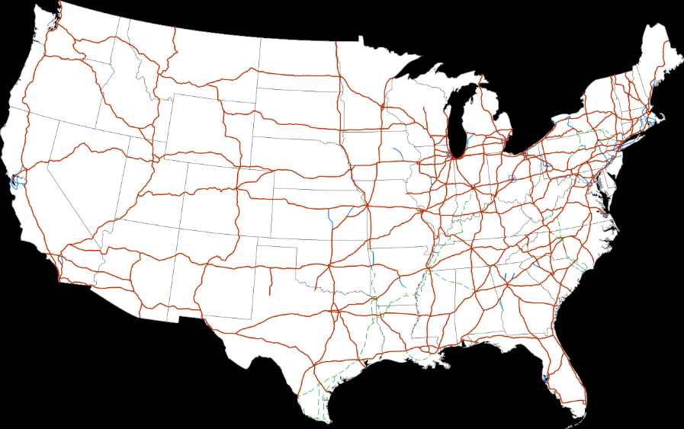
Current Interstate System Map for the integral 48 states.

Slide 45
1950’s
Both bus and train travel declined. By 1960 four-fifths of the American families owned at least one car, an increase of 30% in 20 years. Distribution by household income was:
57% of families with income below $4,000
95% of families with income around $10,000
AAA was answering almost 70 million service calls/year.
Customers could choose among engines, body styles, colors for both interior and exterior, and even hubcaps. Accessories included: radio, heater, air-conditioner for example.
Customers appeared to have the least choice on price. The automobile manufacturers competed energetically with each other, but in technical features, styling, comfort, and safety rather than price. They operated under a system of administered prices.

Slide 46
Average Retail Price of Passenger Cars
Year | Price
1899 | $1,559
1909 | $1,719
1919 | $1,157
1929 | $828
1939 | $845
1947 | $1,580
1955 | $1,910
1959 | $2,060
1963 | $2,310
1972 | $3,879
1982 | $9,903
1993 | $12,750
2002 | $21,866
2012 | $25,552
2019 | $25,449

Slide 47
1954 Mergers – 2 Companies Same Sales
Studebaker and Packard combined as the Studebaker-Packard Corporation.
Packard plant closed in 1956 and moved into the Studebaker Plant. In 1958 Packard name passed into history.
Studebaker had financial problems from a 1932 catastrophe that they could not back from. Studebaker lasted until 1964.
Nash-Kelvinator and Hudson joined forces as the American Motors Corporation. At the time, it was the largest corporate merger in U.S. history.
Ended its reign in 1988 after 34 years of existence.
Poor product planning was the cause of the unfortunate end of the company.
Chrysler Company bought out American Motors in 1987 and officially discontinued the AMC brand.

Slide 48
1956 Packard 400

Slide 49
1957 Studebaker Golden Hawk

Slide 50
1963 Studebaker Lark

Slide 51
1955 Nash Ambassador

Slide 52
1955 Hudson Hornet

Slide 53
Big Three
Ford and Chevrolet staged a furious race year in and year out, with Chevrolet usually have a narrow edge. The full GM line outsold the combined Ford line by a substantial margin.
1956: Ford momentous landmark by first offering stock to the public.
Of the Big Three, Chrysler experienced the greatest difficulties in the 1950’s:
Plymouth lost its 3rd place in sales after 20 years.
GM medium price line: Oldsmobile, Pontiac, or Buick took 3rd place in sales.
DeSoto once popular lost its appeal and was discontinued 1960.

Slide 54
Car Sales 1950-1979
 | Chevy | Ford | Plymouth | 3rd |  |  | Chevy | Ford | Plymouth | 3rd
 | (000) | (000) | (000) | Place |  |  | (000) | (000) | (000) | Place
1950 | 1499 | 1209 | 611 |  |  | 1965 | 2375 | 2171 | 4th | Pontiac
1951 | 1230 | 1013 | 611 |  |  | 1966 | 2207 | 2212 | 4th | Pontiac
1952 | 818 | 672 | 396 |  |  | 1967 | 1948 | 1730 | 4th | Pontiac
1953 | 1347 | 1248 | 651 |  |  | 1968 | 2139 | 1753 | 4th | Pontiac
1954 | 1166 | 1144 | 463 |  |  | 1969 | 2093 | 1827 | 4th | Pontiac
1955 | 1705 | 1451 | 4th | Buick |  | 1970 | 1451 | 2096 | 747
1956 | 1567 | 1409 | 4th | Buick |  | 1971 | 1830 | 2054 | 702
1957 | 1677 | 1506 | 726 |  |  | 1972 | 2421 | 2247 | 4th | Oldsmobile
1958 | 1142 | 988 | 444 |  |  | 1973 | 2580 | 2350 | 5th | Oldsmobile
1959 | 1462 | 1451 | 458 |  |  | 1974 | 2334 | 2180 | 740
1960 | 1653 | 1439 | 484 |  |  | 1975 | 1756 | 1570 | 6th | Oldsmobile
1961 | 1318 | 1339 | 4th | Rambler |  | 1976 | 2104 | 1862 | 6th | Oldsmobile
1962 | 2062 | 1476 | 8th | Pontiac |  | 1977 | 2543 | 1840 | 6th | Oldsmobile
1963 | 2237 | 1525 | 4th | Pontiac |  | 1978 | 2375 | 1924 | 7th | Oldsmobile
1964 | 2319 | 1594 | 4th | Pontiac |  | 1979 | 2285 | 1836 | 9th | Oldsmobile

Slide 55
Coming of the Compacts
Sales of small foreign cars were continuing to climb. 1955 saw 60,000 (less than 1% of the sales of motor vehicles in the U.S).
1955 Rambler (compact) sold 80,000 cars – double its previous record. American Motors was still losing money on President George Romney’s experiment.
Romney's appeal as an auto industry captain was his innovative simplicity and defiance of the Big Three gas-slurping, art deco, tailfin leviathans. Romney was a champion of the American Motors Rambler lineup-- cheap, functional, utilitarian small compacts touting fuel efficiency.
As the 57-58 recession hit America, although in comparison to Great Depression, people started looking at price tags and considering auto upkeep and maintenance.

Slide 56
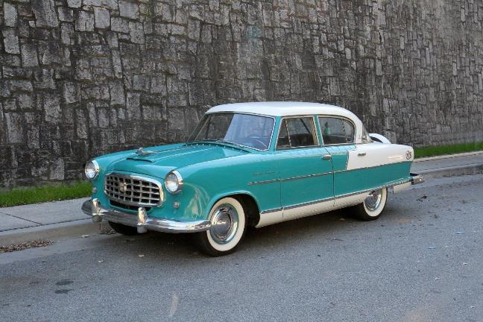
1955 Nash Rambler

Slide 57
Coming of the Compacts
1957: Rambler moved to 12th place 91,469 cars.
1958: Rambler moved to 7th place 162,182 cars.
1959: Rambler moved to 6th place 374,240 cars.
1960: Rambler moved to 4th place 458,841 cars.
1959 AMC earns $60 million profit due to the Rambler.
Imported cars by 1959 skyrocketed to 700,000 a 62% increase over 1958. This was 10% of passenger cars bought. Almost half came from Germany – highly popular Volkswagen.
United Kingdom 2nd, followed in order: France, Sweden, Italy and Japan. Japanese and Swedish were newcomers.

Slide 58
Coming of the Compacts
Domestic automobiles entered the compact car race:
Studebaker Scotsman (1957) & Lark (1958)
Chrysler Valiant (1962) & Dart (1962)
Ford Falcon (1960) & Comet (1960)
GM Corvair (1960), Tempest (1960) & Chevy II (1962)
All of these cars featured economy and ease of operation. They were all bigger than the foreign cars they were competing against.
Chevrolet Corvair was inspired by Volkswagen designed with an air-cooled rear engine. 1960-1969
Compacts made more sense than some of the behemoths that preceded them, but with all the fanfare that was lavished on them, their sales record revealed that the American preference for big cars was unimpaired.

Slide 59
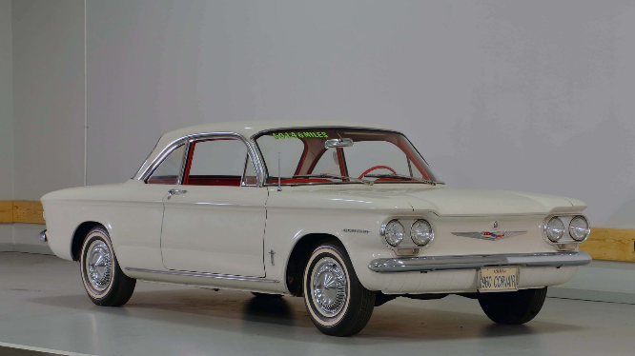
1960 Chevrolet Corvair

Slide 60
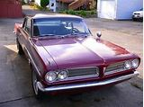
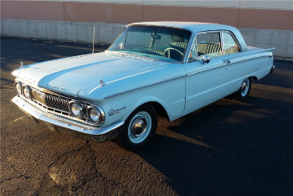
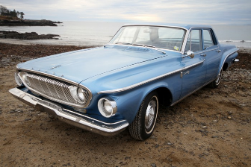
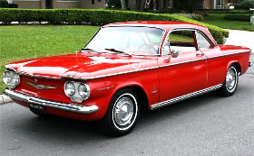
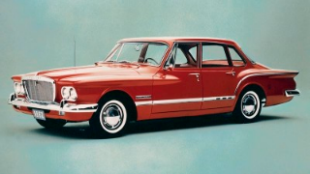
Compact Cars: Pontiac Tempest, Plymouth Valiant, Mercury Comet, Ford Falcon, Dodge Dart, Chevrolet Corvair

Slide 61
1953-1959
1953: Auto production controls from Korean War (ended July 26, 1953) are lifted in February when Eisenhower is President.
1953-54 Big Three sales kills off independent automakers.
1953: Ford and Buick celebrate 50th Anniversary.
Detroit reflected national bent for good times. Each yearly crop was more colorful, complex, and contrived.
Example: between 54 and 55 Chevrolet, Dodge, Plymouth and Pontiac were all transformed from relatively simple family haulers to hot V-8 performers.

Slide 62
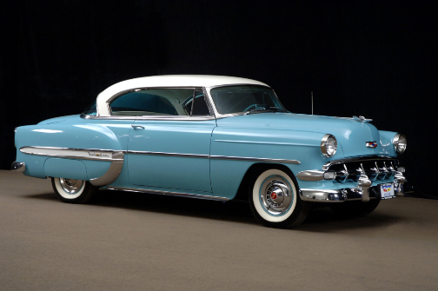
1954 and 1955 Chevrolet Bel Air

Slide 63
1957 Chevrolet Bel Air

Slide 64
Chevrolet Corvette
First model, a convertible, was introduced at GM Motorama (New York auto show) 1953 as concept show car.
Engine: same inline six that powered all other Chevrolet models, but with a higher-compression ratio, three Carter side-draft carburetors, and a more aggressive cam. Output was 150 HP.
Because there was currently no manual transmission available to Chevrolet rated to handle 150 HP, a two-speed Powerglide automatic was used.
To keep tooling costs in line, the body was made out of fiberglass instead of steel. 300 hand-built polo white Corvette convertibles were produced for the 1953.

Slide 65
1953 Corvette

Slide 66
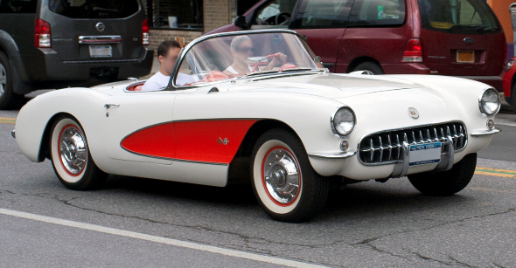
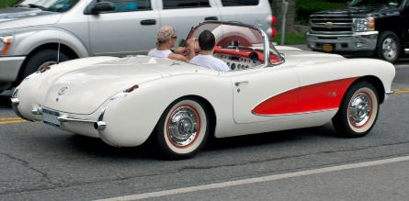
1956 Corvette

Slide 67
Ford Thunderbird
1953 concept was for a two-passenger open car, with a target weight of 2,525 lb, an Interceptor V8 engine based on the forthcoming overhead-valve Ford V8 slated for 1954 model year introduction, and a top speed of over 100 mph.
Henry Ford II in 1953 approved the final design concept to compete with the then new Corvette.
The word "thunderbird" is a reference to a Legendary Creature for North American indigenous people. It is considered a supernatural bird of power and strength.
Production of the Thunderbird began later on in 1954 on September 9 with the car beginning sales as a 1955 model on October 22, 1954.

Slide 68
First generation (1955–1957)
Though inspired by, and positioned directly against, the Corvette, Ford billed the Thunderbird as a personal luxury car, putting a greater emphasis on the car's comfort and convenience features rather than sportiness.
Thunderbird sold exceptionally well and outsold Corvette by more than 23-to-one for 1955 with 16,155 Thunderbirds sold against 700 Corvettes.
1956: Few changes were made to the car for 1956.
Most notable change was moving the spare tire to a continental-style rear bumper in order to make more storage room in the trunk.
New paint colors
Addition of circular porthole windows as standard in the fiberglass roof to improve rearward visibility
312 cu in V8 making 215 hp w/3-speed manual or 225 hp with 2-speed automatic.

Slide 69
First generation (1955–1957)
Thunderbird was revised for 1957 with a reshaped front bumper, a larger grille and tailfins, and larger tail lamps.
Instrument panel was heavily re-styled with round gauges in a single pod, and rear of the car was lengthened, allowing the spare tire to be positioned back in the trunk.
The 312 cu in V8 became standard engine 245 hp.
Though Ford was pleased to see sales of the Thunderbird rise to a record-breaking 21,380 units for 1957, company executives felt the car could do even better, leading to a substantial redesign of the car for 1958. Ford redesigned the Thunderbird into a 4 seat Luxury Personal Car.

Slide 70
First generation (1955–1957)

Slide 71
First generation (1955–1957)

Slide 72
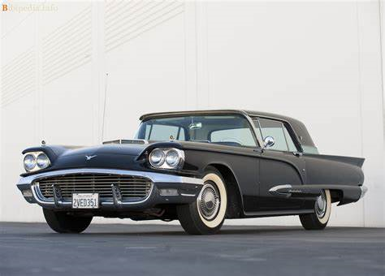
1958 Ford Thunderbird

Slide 73
AMC AMX: two-seat GT-style sports car produced by American Motors Corporation 1968 through 1970.

Slide 74
1950’s Highlights
1955: First McDonald’s drive-in opens.
1955: Chevrolet offers first V-8 engine – 265 CI
1956: Pushbutton automatic transmission selectors: Imperial, Chrysler, Dodge, Plymouth, and Packard.
1956: Highway Hi-Fi record players are optional in Chrysler Corp. cars
1957 June 6: The Automobile Manufacturers Association bans factory sponsored racing and resolves to eliminate speed from advertising.
1957: Pontiac celebrates 50th Anniversary & Oldsmobile the 60th.

Slide 75
1950’s Highlights
1958: America suffers its worse recession of the postwar era – car sales drop 31.4% for the model year. 1958: Unemployment hits 5,437,000 in June – highest since 1941.
1958: Ford release the new model – Edsel with pushbutton automatic transmission controls in the steering wheel.
1958: The Automobile Information Disclosure Act – “Price Label Law” – is passed; window stickers must show make, model, serial number, and suggested retail price.
1958: GM celebrates 50th Anniversary.
1958: Buick dealers now sell the German-built Opal, and Pontiac sells the British Vauxhall. The German built Ford Taunus is available in U.S. First few Toyotas (Toyopets) and Datsuns arrive from Japan.

Slide 76
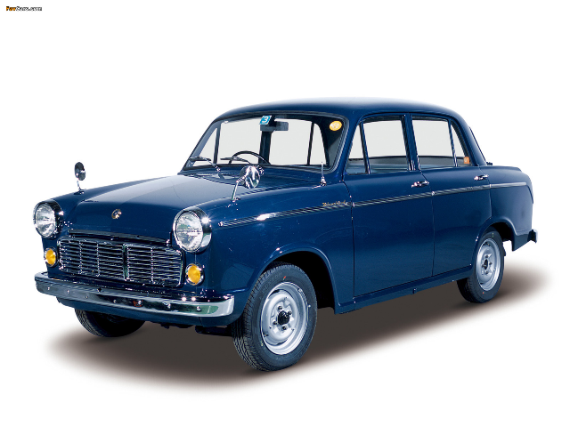
1959 Datsun 310 Bluebird
Datsun (Nissan) entered the American market in 1958, with sales in California. By 1959, the company had dealers across the U.S. and began selling the 310 (known as Bluebird domestically)

Slide 77
1960 Toyota Celica

Slide 78
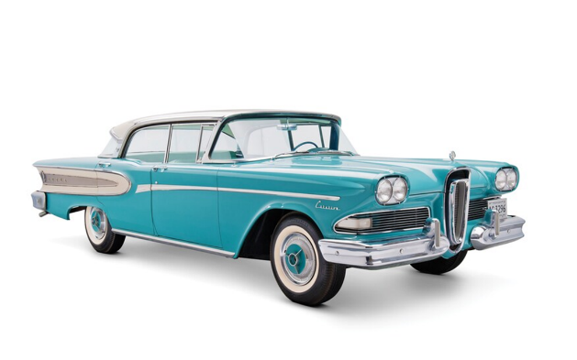
1958 Ford Edsel
Edsel is an automobile marque that was planned, developed, and manufactured by the Ford Motor Company for model years 1958 to 1960.
Ford lost $250 million on the Edsel.
The name "Edsel" became a popular symbol for a commercial failure.

Slide 79
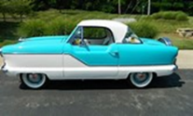
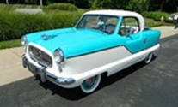
1960’s Highlights
1961: Four new upmarket compacts debut: Buick Special, Oldsmobile f-85, Pontiac Tempest, Dodge Lancer.
1961: A Super Sport option is offered on Chevrolet Impalas at mid-year and it is available with a 409 CI V-8.
1961: DeSoto halts production in November.
1961: Pontiac Tempest offers GM’s first post-war 4-cylinder engine.
1961: Last Nash Metropolitan was sold (412 total). Began 1953.

Slide 80
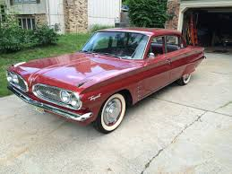
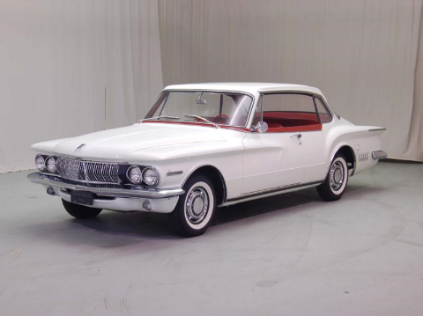
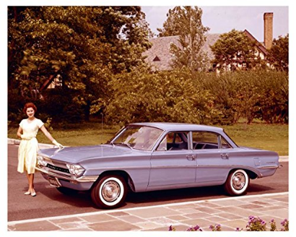
1961 Buick Special, Oldsmobile F-85, Pontiac Tempest, Dodge Lancer

Slide 81
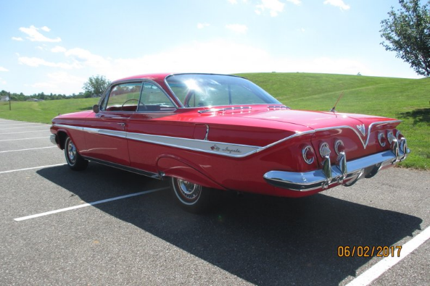
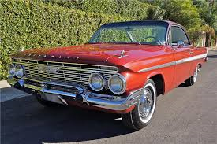
1961 Chevrolet Impala SS

Slide 82
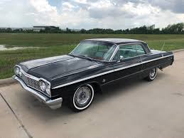
1964 Chevrolet Impala SS

Slide 83
1960’s Highlights
1963: The average full-time worker earns $5243; an average new car sells for $2310.
1963: Half ordered with power steering, 3/4 with automatic transmissions, 2/3 with V-8, and 1/7 with air conditioning.
1963: GM management orders all corporate-sponsored race activity halted.
1963: Nearly 9 million households have more than one automobile up from 4.2 million in 1954.
1964: Specialty and Sporty cars are rapidly gaining favor.

Slide 84
Hi-Performance Automobiles
American hi-performance automobiles date back to 1940’s.
The term “Muscle Car” came into being in the 1960’s.
Many say GM launched the first muscle car engine, the overhead-valve 303 cu in (5.0 L) V8 of 1949, 135 HP.
1949 Oldsmobile Rocket 88 – first basic American hi-performance standards. 3-speed standard or 4-speed hydromatic automatic transmission.
Muscle Car Standard – huge V8 engine in a mid-size body.
Some say the Chrysler 300 Letter Series cars of 1955 were actually the first.

Slide 85
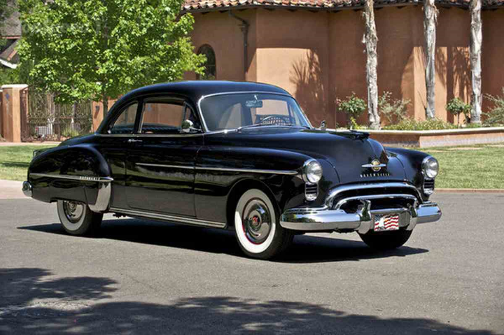
1949 Oldsmobile Rocket 88

Slide 86
1955 Chrysler 300 (Gross HP = 300)

Slide 87
1964 Pontiac GTO
General Motors Corporate policy in 1964 only allowed a full size model to have anything larger than a 330 cubic inch engine.
Pontiac engineers worked around this by offering the 389 cubic engine as an option. The GTO option cost $295.90. (0-60 mph time of 6.8 seconds and a quarter mile time of 14.7 seconds at a 99 mph speed).
Pontiac planned on selling 5,000 GTO’s that first year but 32,450 were eventually sold that first year, starting the American muscle car race.
GTO stands for Gran Turismo Omologato which means officially certified for racing in the Grand Tourer Class.

Slide 88
1964 GTO Hardtop

Slide 89
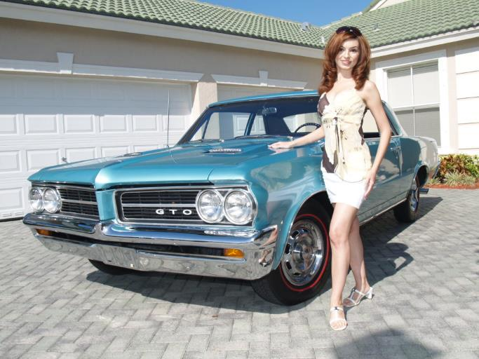
Advertising

Slide 90
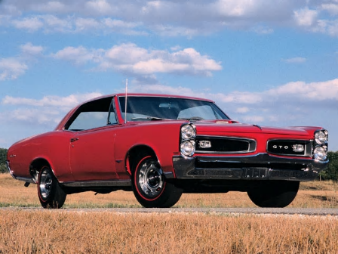
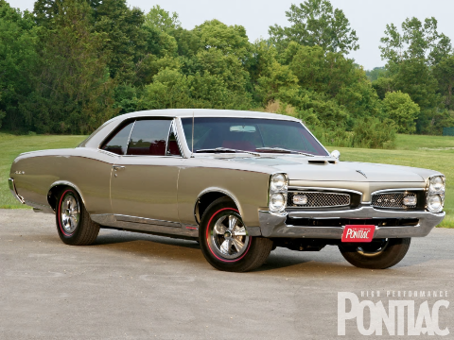
1966 and 1967 GTO

Slide 91
Muscle Cars
Those that loved them – Sixties and early Seventies were alive with Muscle.
Cars with roaring exhausts seamed to squeal away from every redlight.
Actual muscle cars was a relatively low % against the millions of American cars.
Example: 1966 GTO record 96,946 but only 10% of total Pontiac sales.
1966 – Pontiac actually produced 318,270 other Tempest and LeMans models (same size car).

Slide 92
Oldsmobile 442
Second Muscle Car introduced ¾ of 1964 model year (option package for F-85 and Cutlass mid-size car).
Total of 2,999 were sold.
Born out of the competition between Pontiac and Oldsmobile. Hasty response to the GTO, which was an unexpected success.
442 name: A four-barrel carburetor (4), a four-speed manual transmission (4), and dual exhaust (2).

Slide 93
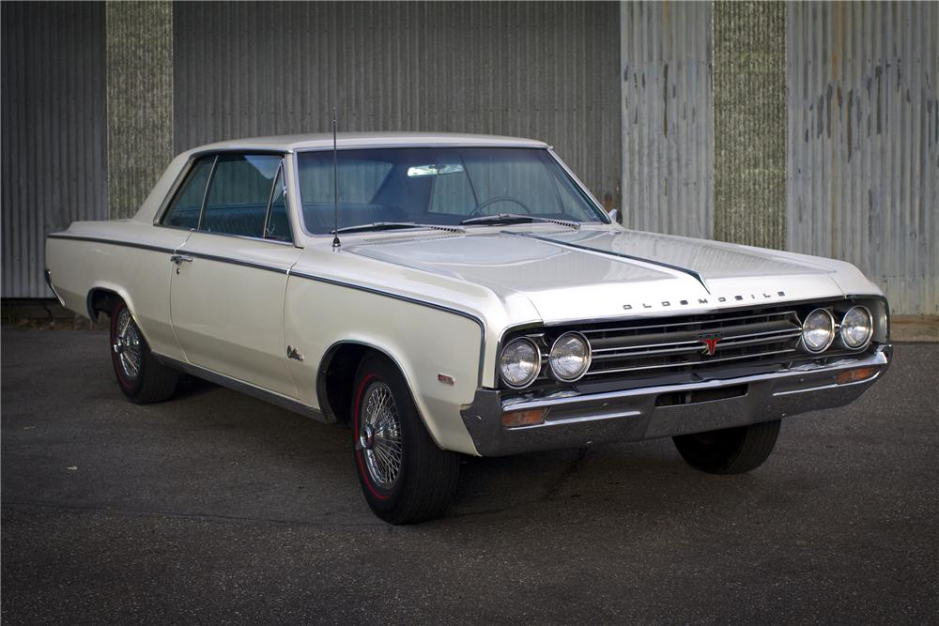
1964 Oldsmobile 442

Slide 94
Other Muscle Cars
Chevrolet Chevelle Malibu SS 1964 w/327 with 300 HP 1965 w/396 with 350 HP ($1,500).
Buick Gran Sport 1965 (mid year) w/401 with 325 HP.
Dodge Coronet 1965 w/426 with 365 HP and with 425 HP version not considered streetable.
Dodge Coronet and Charger 1966 w/383 cubic inch and the 426 cubic inch Street Hemi.
Plymouth Belvedere/Satellite 1966 also had the 426 cubic inch Street Hemi option.
Plymouth Road Runner 1968 w/383 cubic inch with 335 HP and with base price only $2,986

Slide 95
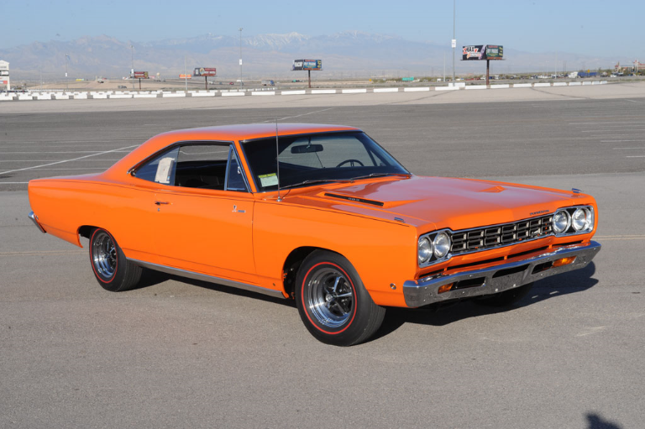
1968 Plymouth Road Runner

Slide 96
Other Muscle Cars
1966 Ford Fairlane w/390 with 335 HP and option w/427 with 425 HP.
1965 Mercury Comet Cyclone GT w/390 with 335 HP and option 427 with 425 HP.
AMC gained some muscle-car credibility in 1967
Marlin w/new 280 HP, 343 Typhoon V8 engine
Rebel w/new 280 HP, 343 Typhoon V8 engine and 315 HP, 390 cubic inch base price only $2996. Red, White, Blue paint job

Slide 97
AMC Rebel

Slide 98
Advertising
Commercials were seen with tigers.
Commercial advertising 1965 GTO - girls were often seen driving the GTO, the announcer stated G-T-O wasn't meant to mean "Girls Take Over.“
Jokesters of the time also claimed that GTO stood for "Gas, Tires, Oil”.
Fans and owners of the Pontiac GTO proudly call their favorite car a "Goat“

Slide 99
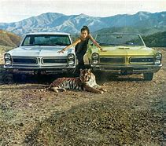
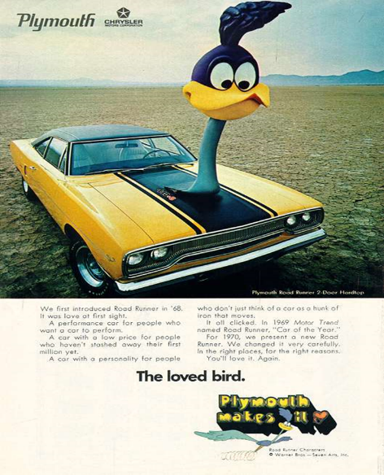
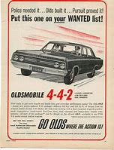
GTO Tiger

Slide 100
Car Songs in 60’s
Little GTO by Artist: Ronny & the Daytonas
Lyrics:
“Little GTO, you’re really lookin’ fine.
Three Deuces and a 4-speed and a 389.
Listen to her tackin’ up now.
Listen to her why-ee-eye-ine.
C’mon and turn it on.

Slide 101
Pony Car History - America's Smaller Muscle Cars
Definition of a Pony Car is a small bodied vehicle with a large engine. The name originated from first Pony Car – Ford Mustang.
Other Pony Cars: Plymouth Barracuda, Chevrolet Camaro, Pontiac Firebird, Mercury Cougar, AMC Javelin, and Dodge Challenger.
Beginning: With the Ford Thunderbird going from a two seat speedster to a four seat luxury car in 1958, Ford was looking for a new model to take it's place. The new styled Thunderbird was selling well, but the dealers wanted something similar to the old Thunderbird, to bring the younger crowd into the showrooms.
Younger generation - a lot of disposable income. Surveys done by Ford suggested these buyers were looking for something a little more sportier than the sedans currently available.
Similar to the muscle car, pony cars had a big impact on a generation.

Slide 102
First generation (1964–1973) Ford Mustang
Mustang is still being produced today, and was one of the most successful models when it debuted, selling nearly 680,000 in it's first year.
Original Ford Mustang debuted on April 17, 1964, at the attractive price of $2,368. Dubbed 1964½ model.
Dealers were inundated with requests for the sleekly-styled new vehicle. On the first day, dealers took 22,000 orders.
In Garland, Texas, 15 customers thronged to bid on the same Mustang. The winning bidder resorted to sleeping overnight in his new car so that it wouldn’t be sold out from under him before his check could clear.

Slide 103
Mustang
Ford initially forecasted annual sales of 100,000 units.
During the Mustang’s first 12 months on the market, sales built to an astounding 417,000.
Within two years, sales had catapulted to one million.
It made an appearance in the James Bond film Goldfinger (film) in September of 1964.
It was one of the most successful product launches in automotive history.

Slide 104
1964 Ford Mustang

Slide 105
1964 Ford Mustang

Slide 106
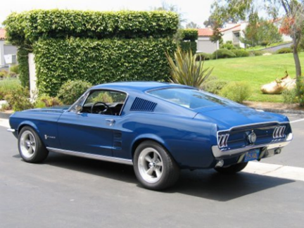
Ford Mustang GTA Fastback 1967

Slide 107
1967 Pontiac Firebird

Slide 108
1967 Chevrolet Camaro

Slide 109
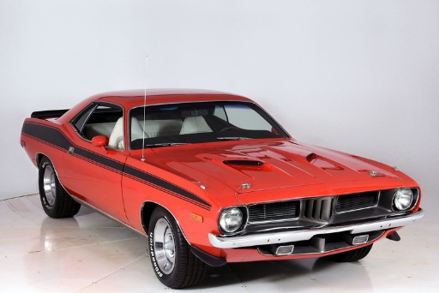
1964 Plymouth Barracuda (End 1974)

Slide 110
1970 Dodge Challenger (End 1974)

Slide 111
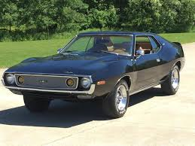
1967 AMC Javelin (End 1974)

Slide 112
Second generation (1974–1978) Mustang
Lee Iacocoa, who had been one of the forces behind the original Mustang, became President of Ford Motor Company in 1970 and ordered a smaller, more fuel-efficient Mustang for 1974. Initially it was to be based on the Maverick, but ultimately based on Pinto subcompact.
New model, called the "Mustang II", was introduced two months before the first 1973 oil crisis, and its reduced size allowed it to compete against imported sports coupés such as the Japanese Toyota Celica and European Ford Capri (then Ford-built in Germany and Britain, sold in U.S.)
First-year sales were 385,993 cars, compared with the original Mustang's twelve-month sales record of 418,812.

Slide 113
1974 Ford Mustang II 1978 Ford Mustang Cobra

Slide 114
Muscle Car Demise
Prior to 1972 HP measured Gross – no accessories.
1972 Net measurements were phased in. Power still measured at the flywheel but all the accessories were installed including the full exhaust system, emission controls, all pumps and the alternator.
Net can’t be compared exactly to SAE Gross because there are just too many variations in measuring, but it is down around 80%. So power ratings dropped.
1973 horsepower ratings went down again as power sapping emission controls were tightened.

Slide 115
Muscle Car Demise
Insurance: To sell, companies started increase HP ratings. Safety legislators noticed and insurance companies who started charging more for insurance.
1967: A guy under 25 with a clean driving record would have paid $700 a year for GTO coverage. Some car companies lowered their advertised horsepower ratings. 1972 Insurance on a 1971 Dodge Challenger per year was about the same as 12 month car payments.
Ralph Nader's book, "Unsafe at Any Speed," published in 1965 caused a national backlash against these dangerous cars.
1975 U.S. emissions regulations caused most automobile engines to be fitted with catalytic converters eliminating most true dual exhausts.

Slide 116
Muscle Car Demise
1975 most muscle cars had been discontinued or heavily downgraded, effectively ending the muscle car era.
1973 many muscle cars were a shadow of their former selves.
OPEC Oil Embargo: Oil Crisis late 73 finished off Muscle Cars.
Long lines at gas stations and soaring prices were a real shock.
Federal Government established 55 mph national speed limit.
Gas guzzlers were irresponsible, expensive and unwanted, it didn't matter how much fun they were.

Slide 117
Sub-Compact Cars
Ford Pinto 1971 to 1980 model years. The smallest American Ford vehicle since 1907, the Pinto was the first subcompact vehicle produced by Ford.
Since the 1970s, the safety reputation of the Pinto has been surrounded by controversy.
Its fuel-tank design attracted both media and government scrutiny after several deadly fires related to the tanks rupturing during rear-end collisions.
Subsequent analysis of overall safety of the Pinto suggested it was comparable to other 1970s subcompact cars.
Safety issues surrounding the Pinto and the subsequent response by Ford have been cited widely as a business ethics as well as tort reform case study.

Slide 118
Sub-Compact Cars
American automakers had first countered imports such as the Volkswagen Beetle with compact cars including the Ford Falcon, Ford Maverick, Chevrolet Corvair and Plymouth Valiant, although these cars featured six-cylinder engines and comprised a larger vehicle class.
As the popularity of smaller Japanese imports from Toyota and Datsun increased throughout the 1960s, Ford responded by introducing the Cortina from Ford of Europe as a captive import.
American automakers would soon introduce their own subcompacts. These were led by the AMC Gremlin, which arrived six months before the Pinto, and Chevrolet Vega, introduced day before the Pinto.
Named for the pony, the Pinto was introduced on September 11, 1970. Pinto was a completely new platform, but utilized a powertrain from the European-specification Escort.

Slide 119
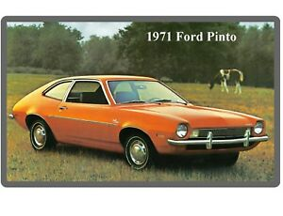
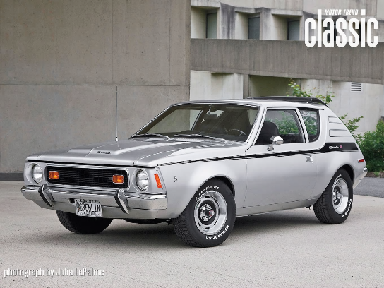
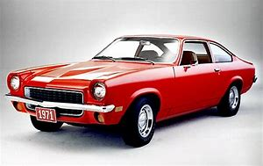
1971 Ford Pinto, Chevrolet Vega, AMC Gremlin

